Slide 1
Module 2 Data Representation Part 1
Fixed point representation of numbers-algorithms for arithmetic operations: multiplication (Booths, Modified Booths) - division (restoring and non-restoring) - Floating point representation with IEEE standards and algorithms for common arithmetic operations- Representation of nonnumeric
data (character codes).

Slide 2
Integer Representation
Only have 0 & 1 to represent everything
Positive numbers stored in binary
e.g. 41=00101001
No minus sign
No period
Three possible approaches:
a) Sign-magnitude representation
b) One’s complement representation
c) Two’s complement representation

Slide 3
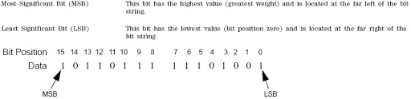
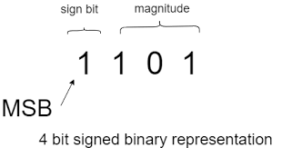
In integer
MSB-Most significant Bit
LSB-Least Significant Bit
If MSB is 0 then the integer is +ve number
MSB is 1 then the integer is –ve number

Slide 4
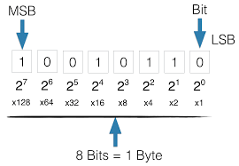
The value of bits in signed and unsigned binary numbers
 | Bit 7 | Bit 6 | Bit 5 | Bit 4 | Bit 3 | Bit 2 | Bit 1 | Bit 0
Unsigned | 27 = 128 | 26 = 64 | 25 = 32 | 24= 16 | 23= 8 | 22 = 4 | 21 = 2 | 20 = 1
Signed | -(27) = -128 | 26 = 64 | 25 = 32 | 24 = 16 | 23 = 8 | 22 = 4 | 21= 2 | 20 = 1

Slide 5
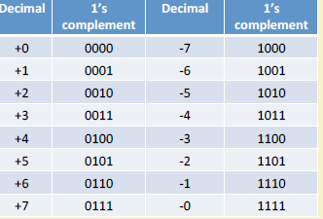

Slide 6
Integer Representation (cont’d)
Sign Magnitude: One's Complement Two's Complement 000 = +0 000 = +0 000 = +0 001 = +1 001 = +1 001 = +1 010 = +2 010 = +2 010 = +2 011 = +3 011 = +3 011 = +3
100 = -0 100 = -3 100 = -4 101 = -1 101 = -2 101 = -3 110 = -2 110 = -1 110 = -2 111 = -3 111 = -0 111 = -1
Issues: balance, number of zeros, ease of operations
Which one is best? Why?

Slide 7
SUMMARY OF THE TABLE
SIGN & MAGNITUE SYSTEM: Negative value is obtained by changing the sign bit (MSB)
SIGNED 1’S COMPLEMENT: Negative number is obtained by complementing each bit of the corresponding positive number i.e (2n-1) –N
SIGNED 2’S COMPLEMENT: Negative number is obtained by taking 2’s complement of positive number
2 ^{n}-N
Range: - (2^{n-1}) to + (2^{n-1}-1)

Slide 8
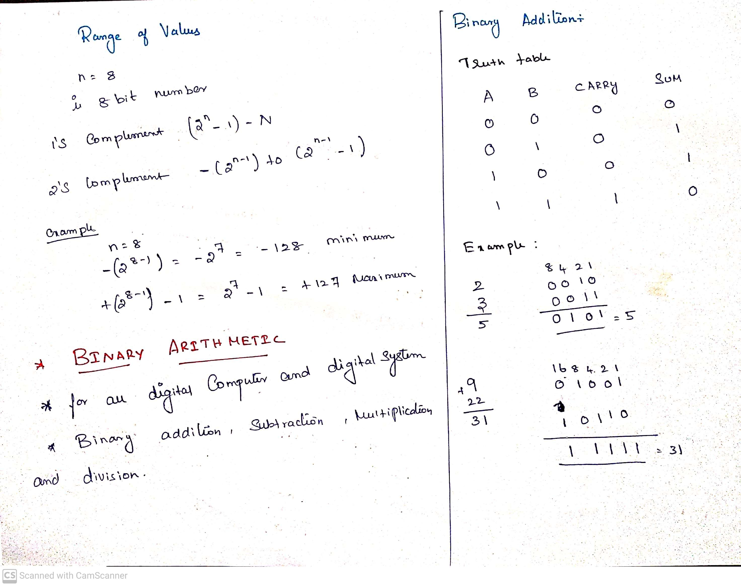

Slide 9
Binary Subtraction
Subtraction and Borrow, these two words will be used very frequently for the binary subtraction. There four rules of the binary subtraction.

Slide 10
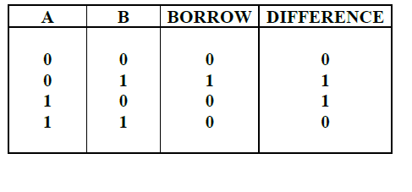
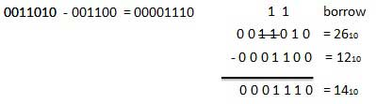

Slide 11
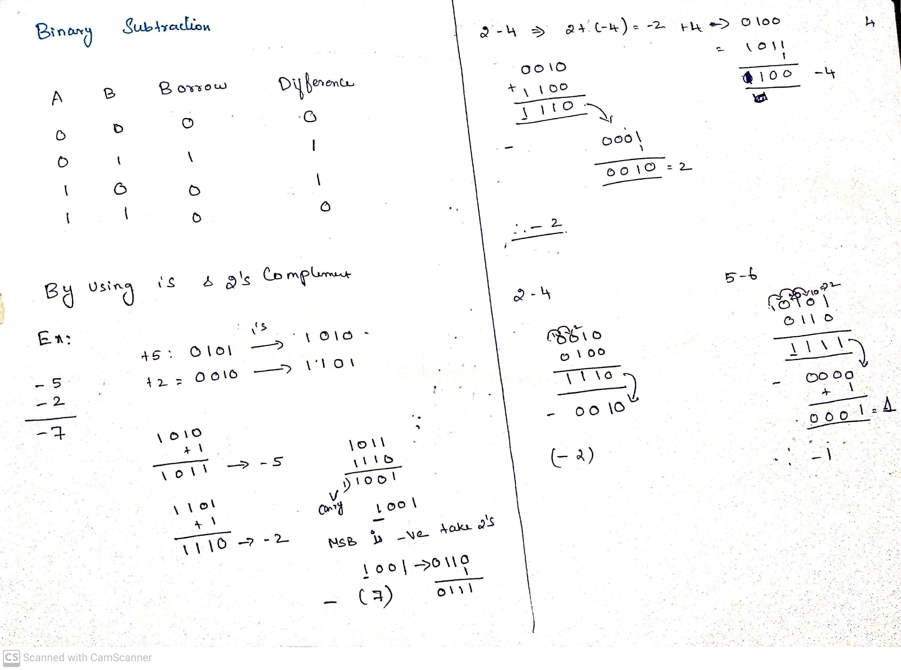

Slide 12
Binary Multiplication
Binary multiplication is similar to decimal multiplication. It is simpler than decimal multiplication because only 0s and 1s are involved. There four rules of the binary multiplication.

Slide 13
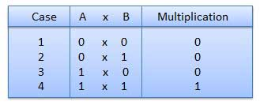
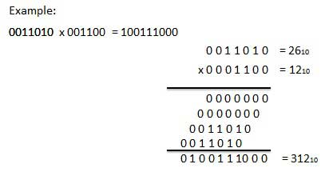

Slide 14
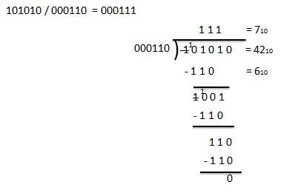
Binary Division
Binary division is similar to decimal division. It is called as the long division procedure

Slide 15
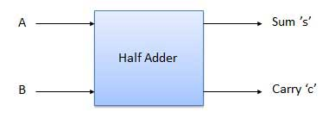
Half Adder
Half adder is a combinational logic circuit with two input and two output. The half adder circuit is designed to add two single bit binary number A and B. It is the basic building block for addition of two single bit numbers. This circuit has two outputs carry and sum.

Slide 16
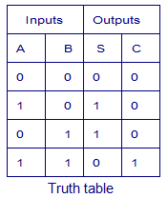
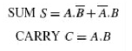
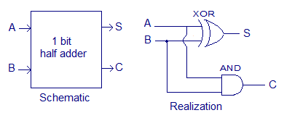
Truth Table and Circuit Diagram
Boolean Expression

Slide 17
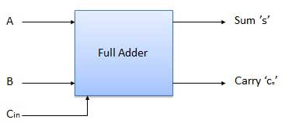
Full Adder
Full adder is developed to overcome the drawback of Half Adder circuit. It can add two one-bit numbers A and B, and carry c. The full adder is a three input and two output combinational circuit.

Slide 18
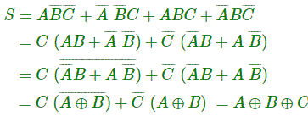
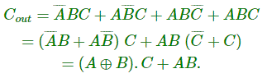
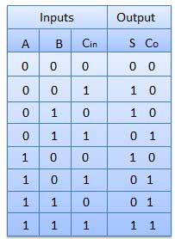
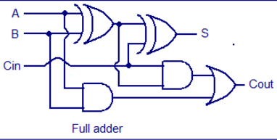
Truth Table and Circuit Diagram

Slide 19
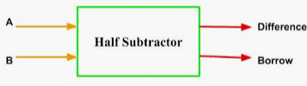
Half Subtractor
Half subtractor is a combination circuit with two inputs and two outputs (difference and borrow). It produces the difference between the two binary bits at the input and also produces a output (Borrow) to indicate if a 1 has been borrowed. In the subtraction (A-B), A is called as Minuend bit and B is called as Subtrahend bit.

Slide 20
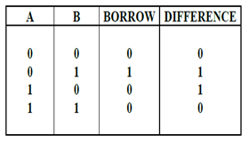
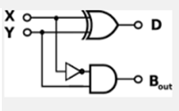
Truth Table and Circuit Diagram
From the truth table, Boolean Expression can be derived as:
D = A’B + AB’ = A ⊕ B
B_{o} = A’B

Slide 21
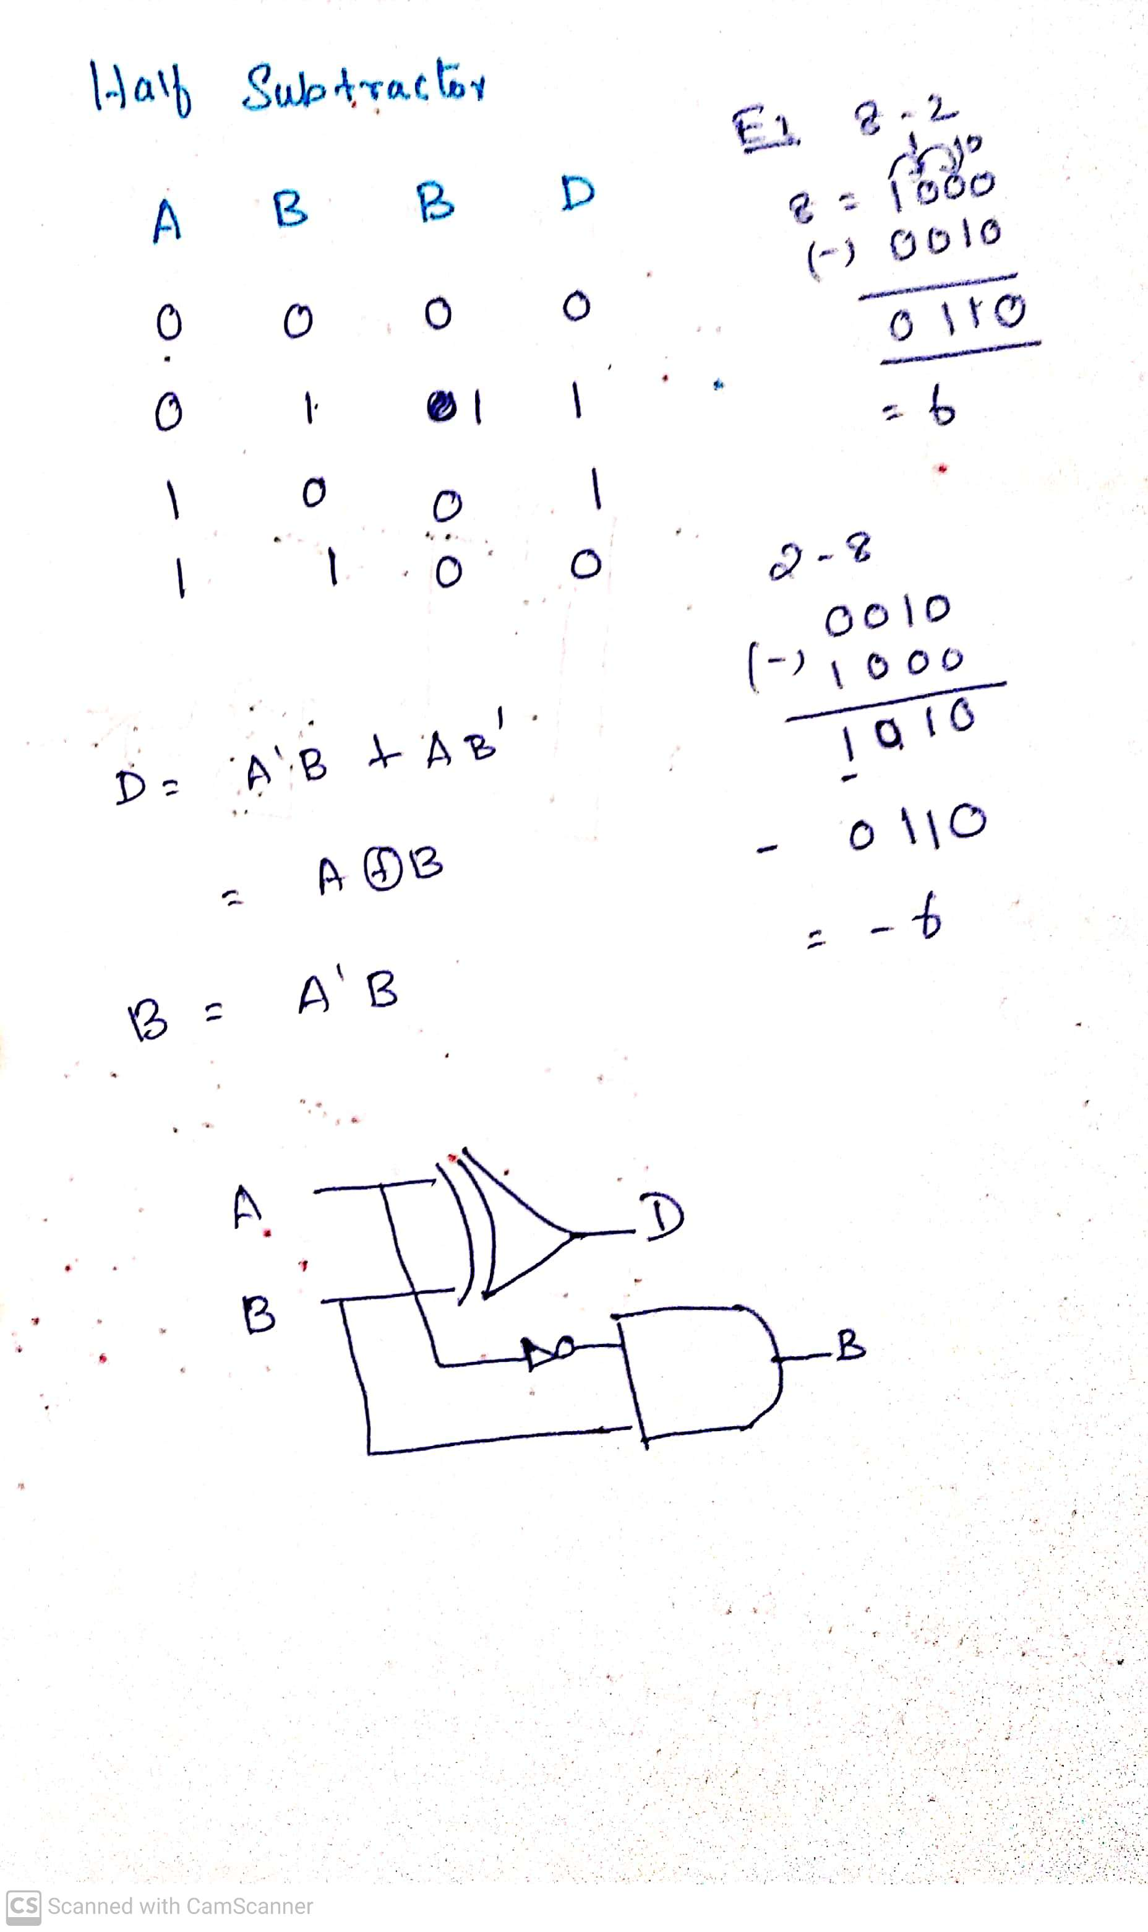
Half Subtractors

Slide 22
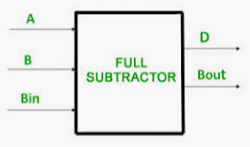
Full Subtractor
The disadvantage of a half subtractor is overcome by full subtractor. The full subtractor is a combinational circuit with three inputs A, B, Bin and two output D and Bo. A is the minuend, B is subtrahend, Bin is the borrow produced by the previous stage, D is the difference output and Bo is the borrow output.

Slide 23
Ripple Carry Adder
Example: 4-bit Carry Ripple Adder
Assume to add two operands A and B where
A = A3 A2 A1 A0
B = B3 B2 B1 B0
A= 1 0 1 1 +
B = 1 1 0 1
--------------------
A+B=1 1 0 0 0
Cout S3 S2 S1 S0

Slide 24
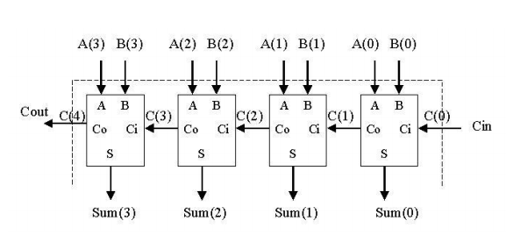

Slide 25
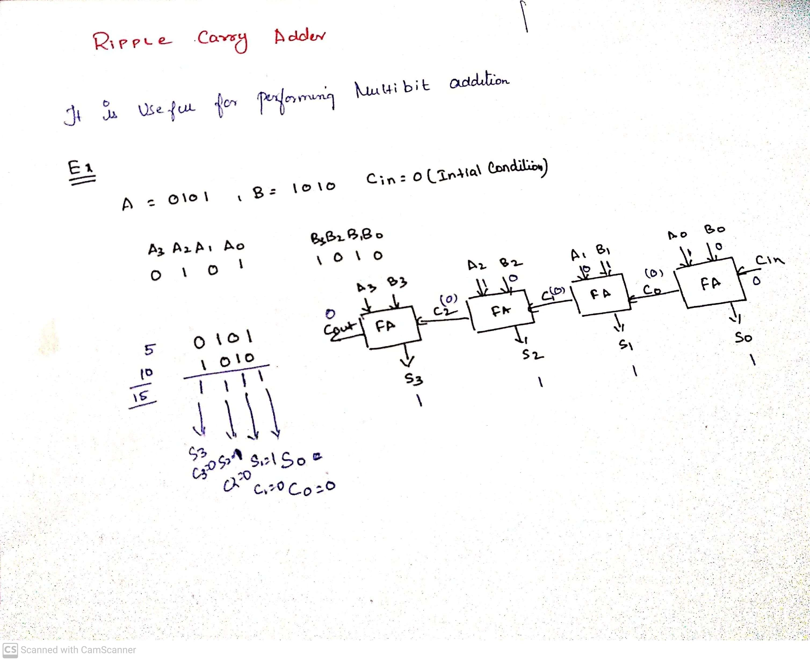
example

Slide 26
Ripple Carry Adder
4-bit Adder
A 4-bit adder circuit can be designed by first designing the 1-bit full adder and then connecting the four 1-bit full adders to get the 4-bit adder as shown in the diagram above.
For the 1-bit full adder, the design begins by drawing the Truth Table for the three input and the corresponding output SUM and CARRY.
The Boolean Expression describing the binary adder circuit is then deduced.
The binary full adder is a three input combinational circuit which satisfies the truth table given below.

Slide 27
Binary Multiplier
Multiplication of binary numbers is performed in the same way as with decimal numbers. The multiplicand is multiplied by each bit of the multiplier, starting from the least significant bit.
The result of each such multiplication forms a partial product. Successive partial products are shifted one bit to the left.
The product is obtained by adding these shifted partial products.
Example 1: Consider multiplication of two numbers, say A and B (2 bits each),
C = A x B.

Slide 28
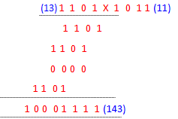
Binary Multiplier
Unsigned number multiplication
two n-bit numbers; 2n-bit result

Slide 29
Binary Multiplier
The first partial product is formed by multiplying the B1B0 by A0. The multiplication of two bits such as A0 and B0 produces a 1 if both bits are 1; otherwise it produces a 0 like an AND operation. So the partial products can be implemented with AND gates.
The second partial product is formed by multiplying the B1B0 by A1 and is shifted one position to the left.
The two partial products are added with two half adders (HA). Usually there are more bits in the partial products, and then it will be necessary to use FAs.

Slide 30
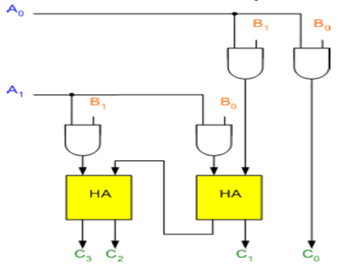
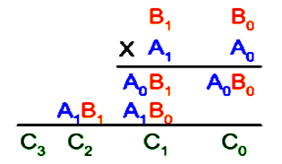
Binary Multiplier

Slide 31
Binary Multiplier
The least significant bit of the product does not have to go through an adder, since it is formed by the output of the first AND gate as shown in the Figure.

Slide 32
Shift-and-Add Multiplier
Shift-and-add multiplication is similar to the multiplication performed by paper and pencil.
This method adds the multiplicand X to itself Y times, where Y denotes the multiplier.
To multiply two numbers by paper and pencil, the algorithm is to take the digits of the multiplier one at a time from right to left, multiplying the multiplicand by a single digit of the multiplier and placing the intermediate product in the appropriate positions to the left of the earlier results.

Slide 33
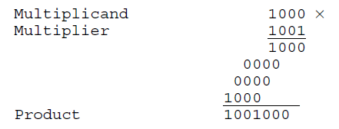
Shift-and-Add Multiplier
As an example, consider the multiplication of two unsigned 4-bit numbers,
8 (1000) and 9 (1001).

Slide 34
Shift-and-Add Multiplier
In the case of binary multiplication, since the digits are 0 and 1, each step of the multiplication is simple.
If the multiplier digit is 1, a copy of the multiplicand (1 ×multiplicand) is placed in the proper positions;
If the multiplier digit is 0, a number of 0 digits (0 × multiplicand) are placed in the proper positions.
Consider the multiplication of positive numbers. The first version of the multiplier circuit, which implements the shift-and-add multiplication method for two n-bit numbers, is shown in Figure.

Slide 35
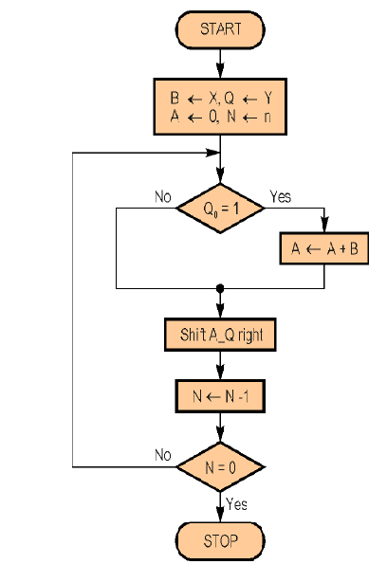
Shift - and - Add multiplier

Slide 36
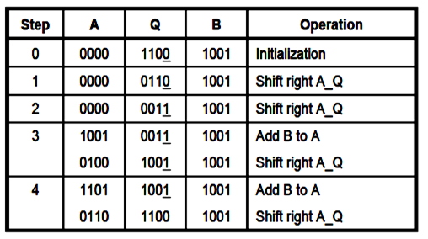
Shift-and-Add Multiplier
For Example, Perform the multiplication 9 x 12
(1001 x 1100). Finally, both A and Q contains the result of product.

Slide 37
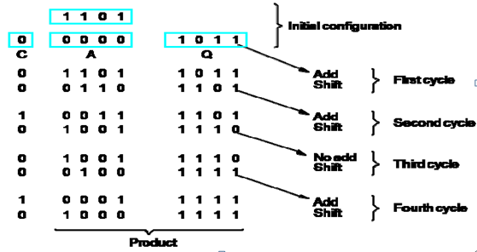
Shift-and-Add Multiplier
Example 2:
A = 0000 M ( Multiplicand) → 13 ( 1 1 0 1) Q(Multiplier) → 11 (1 0 1 1).

Slide 38
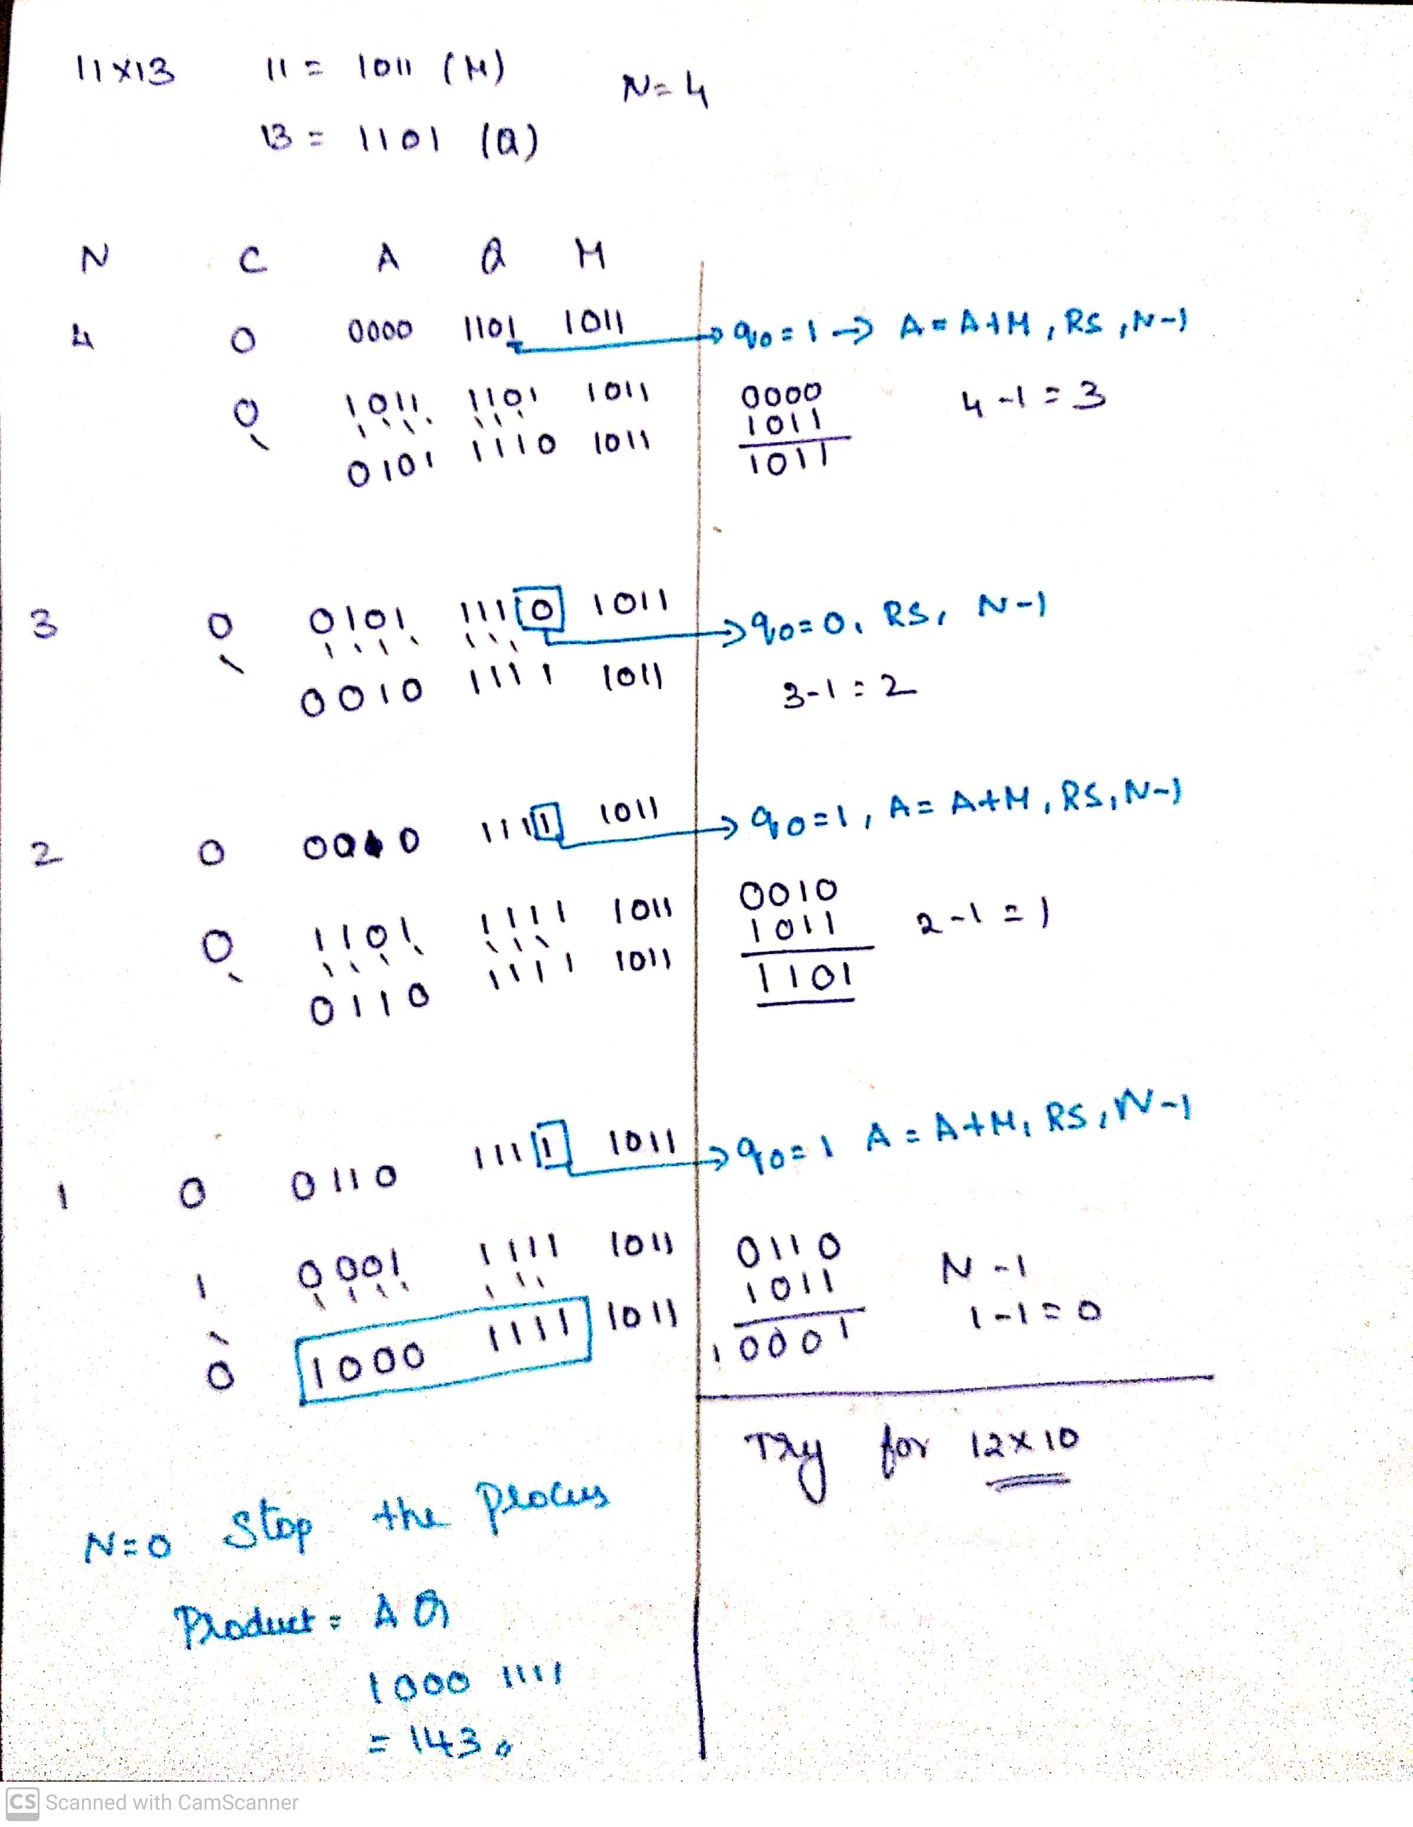

Slide 39
Signed Multiplication - Booth Algorithm
A powerful algorithm for signed number multiplication is Booth’s algorithm which generates a 2n bit product and treats both positive and negative numbers uniformly.
This algorithm suggest that we can reduce the number of operations required for multiplication by representing multiplier as a difference between two numbers.

Slide 40
Signed Multiplication - Booth Algorithm
A powerful algorithm for signed number multiplication is Booth’s algorithm which generates a 2n bit product and treats both positive and negative numbers uniformly.
This algorithm suggest that we can reduce the number of operations required for multiplication by representing multiplier as a difference between two numbers.

Slide 41
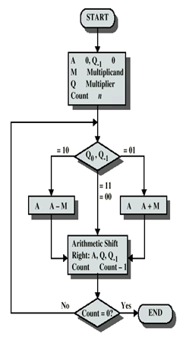
Signed Multiplication - Booth Algorithm

Slide 42
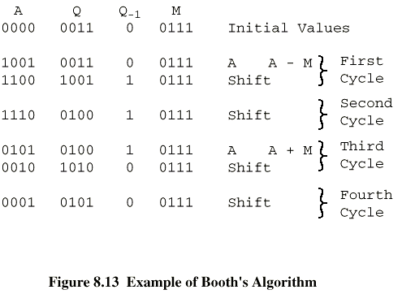
Signed Multiplication - Booth Algorithm

Slide 43
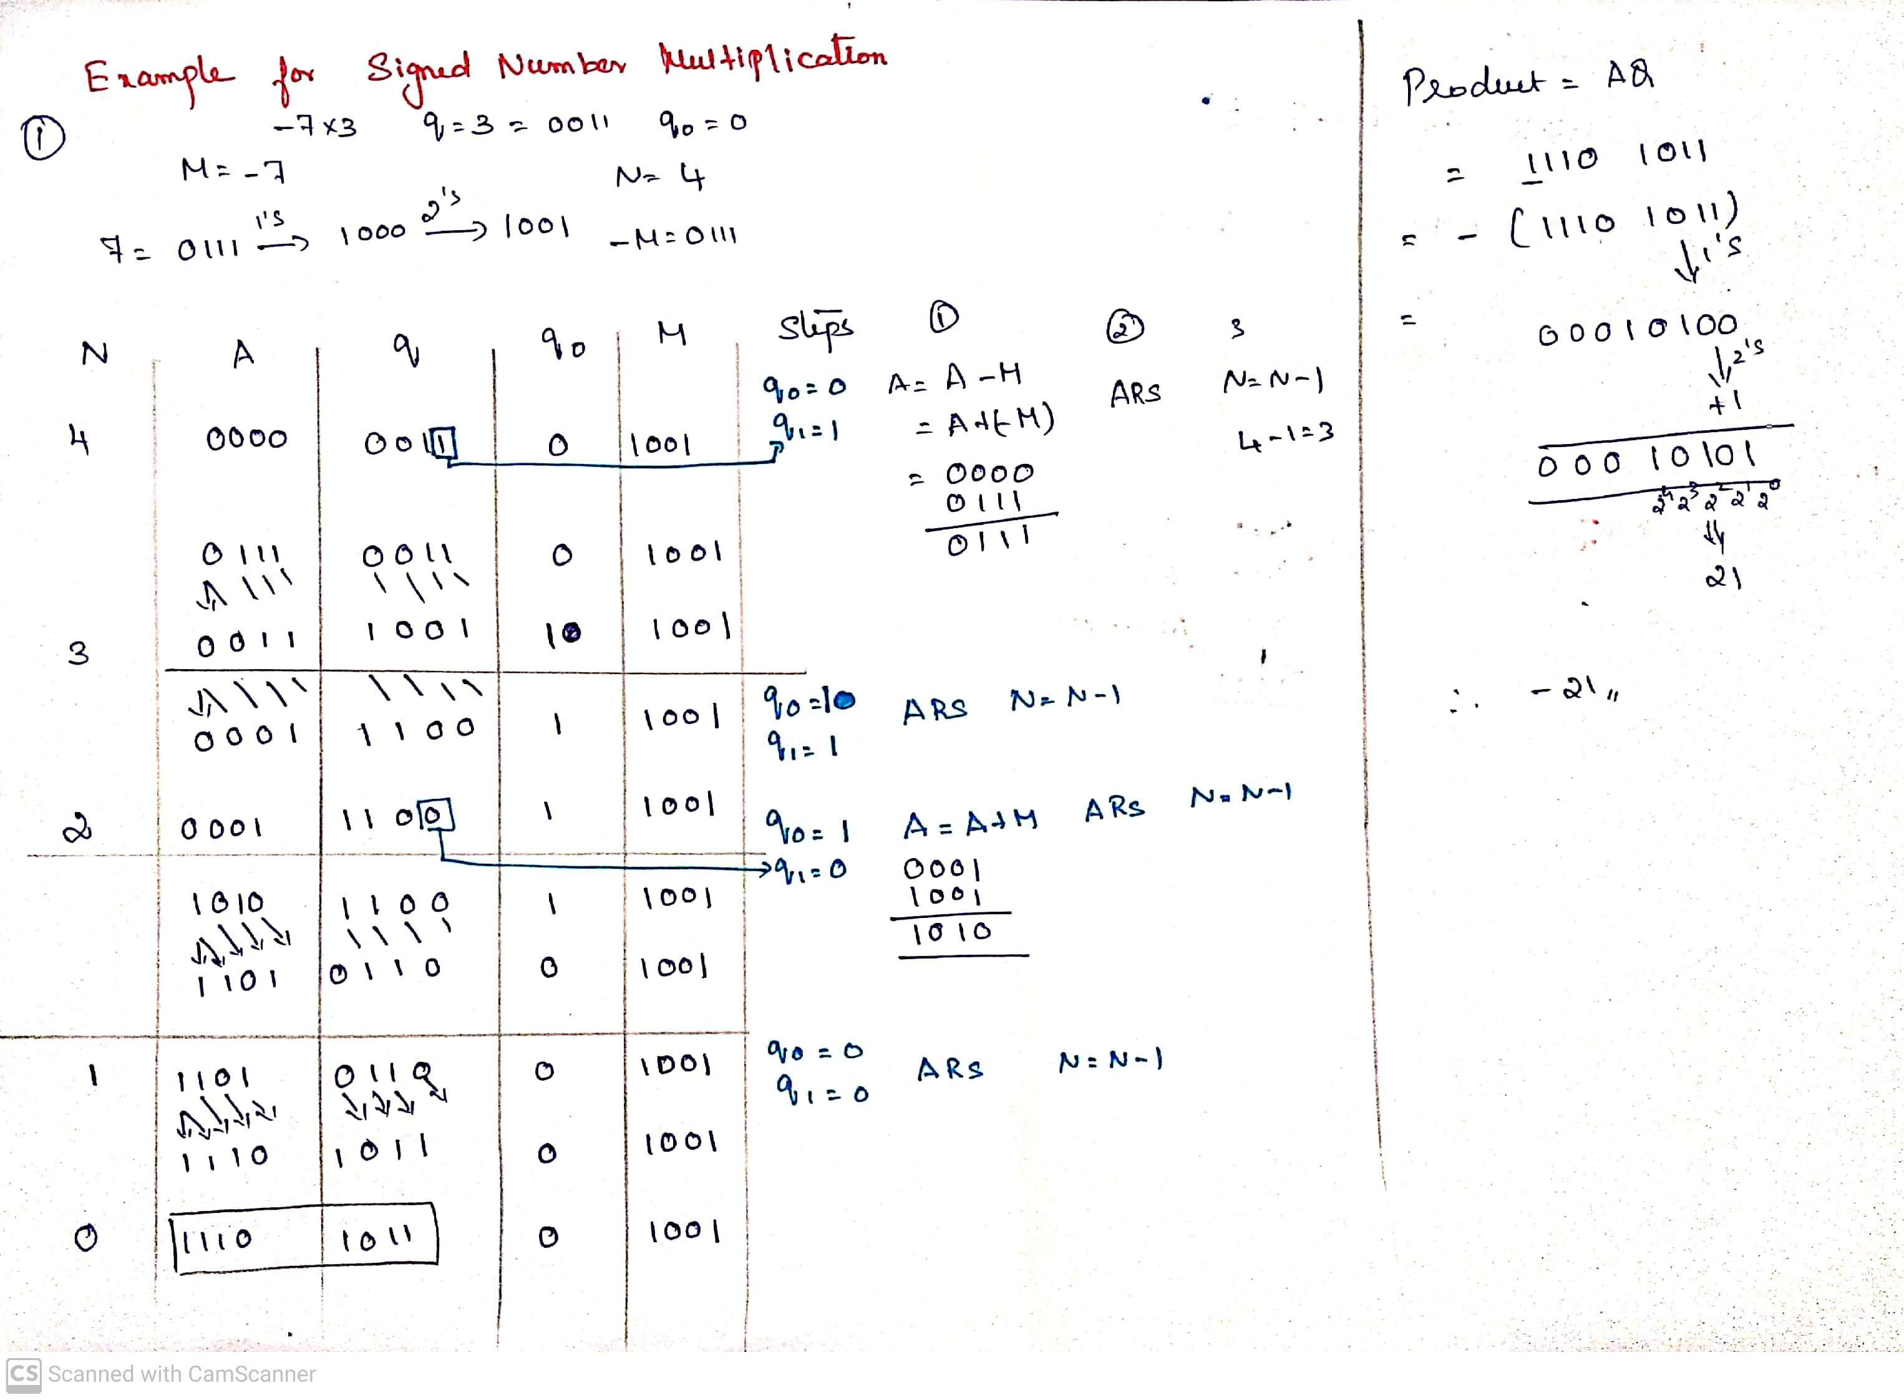

Slide 44
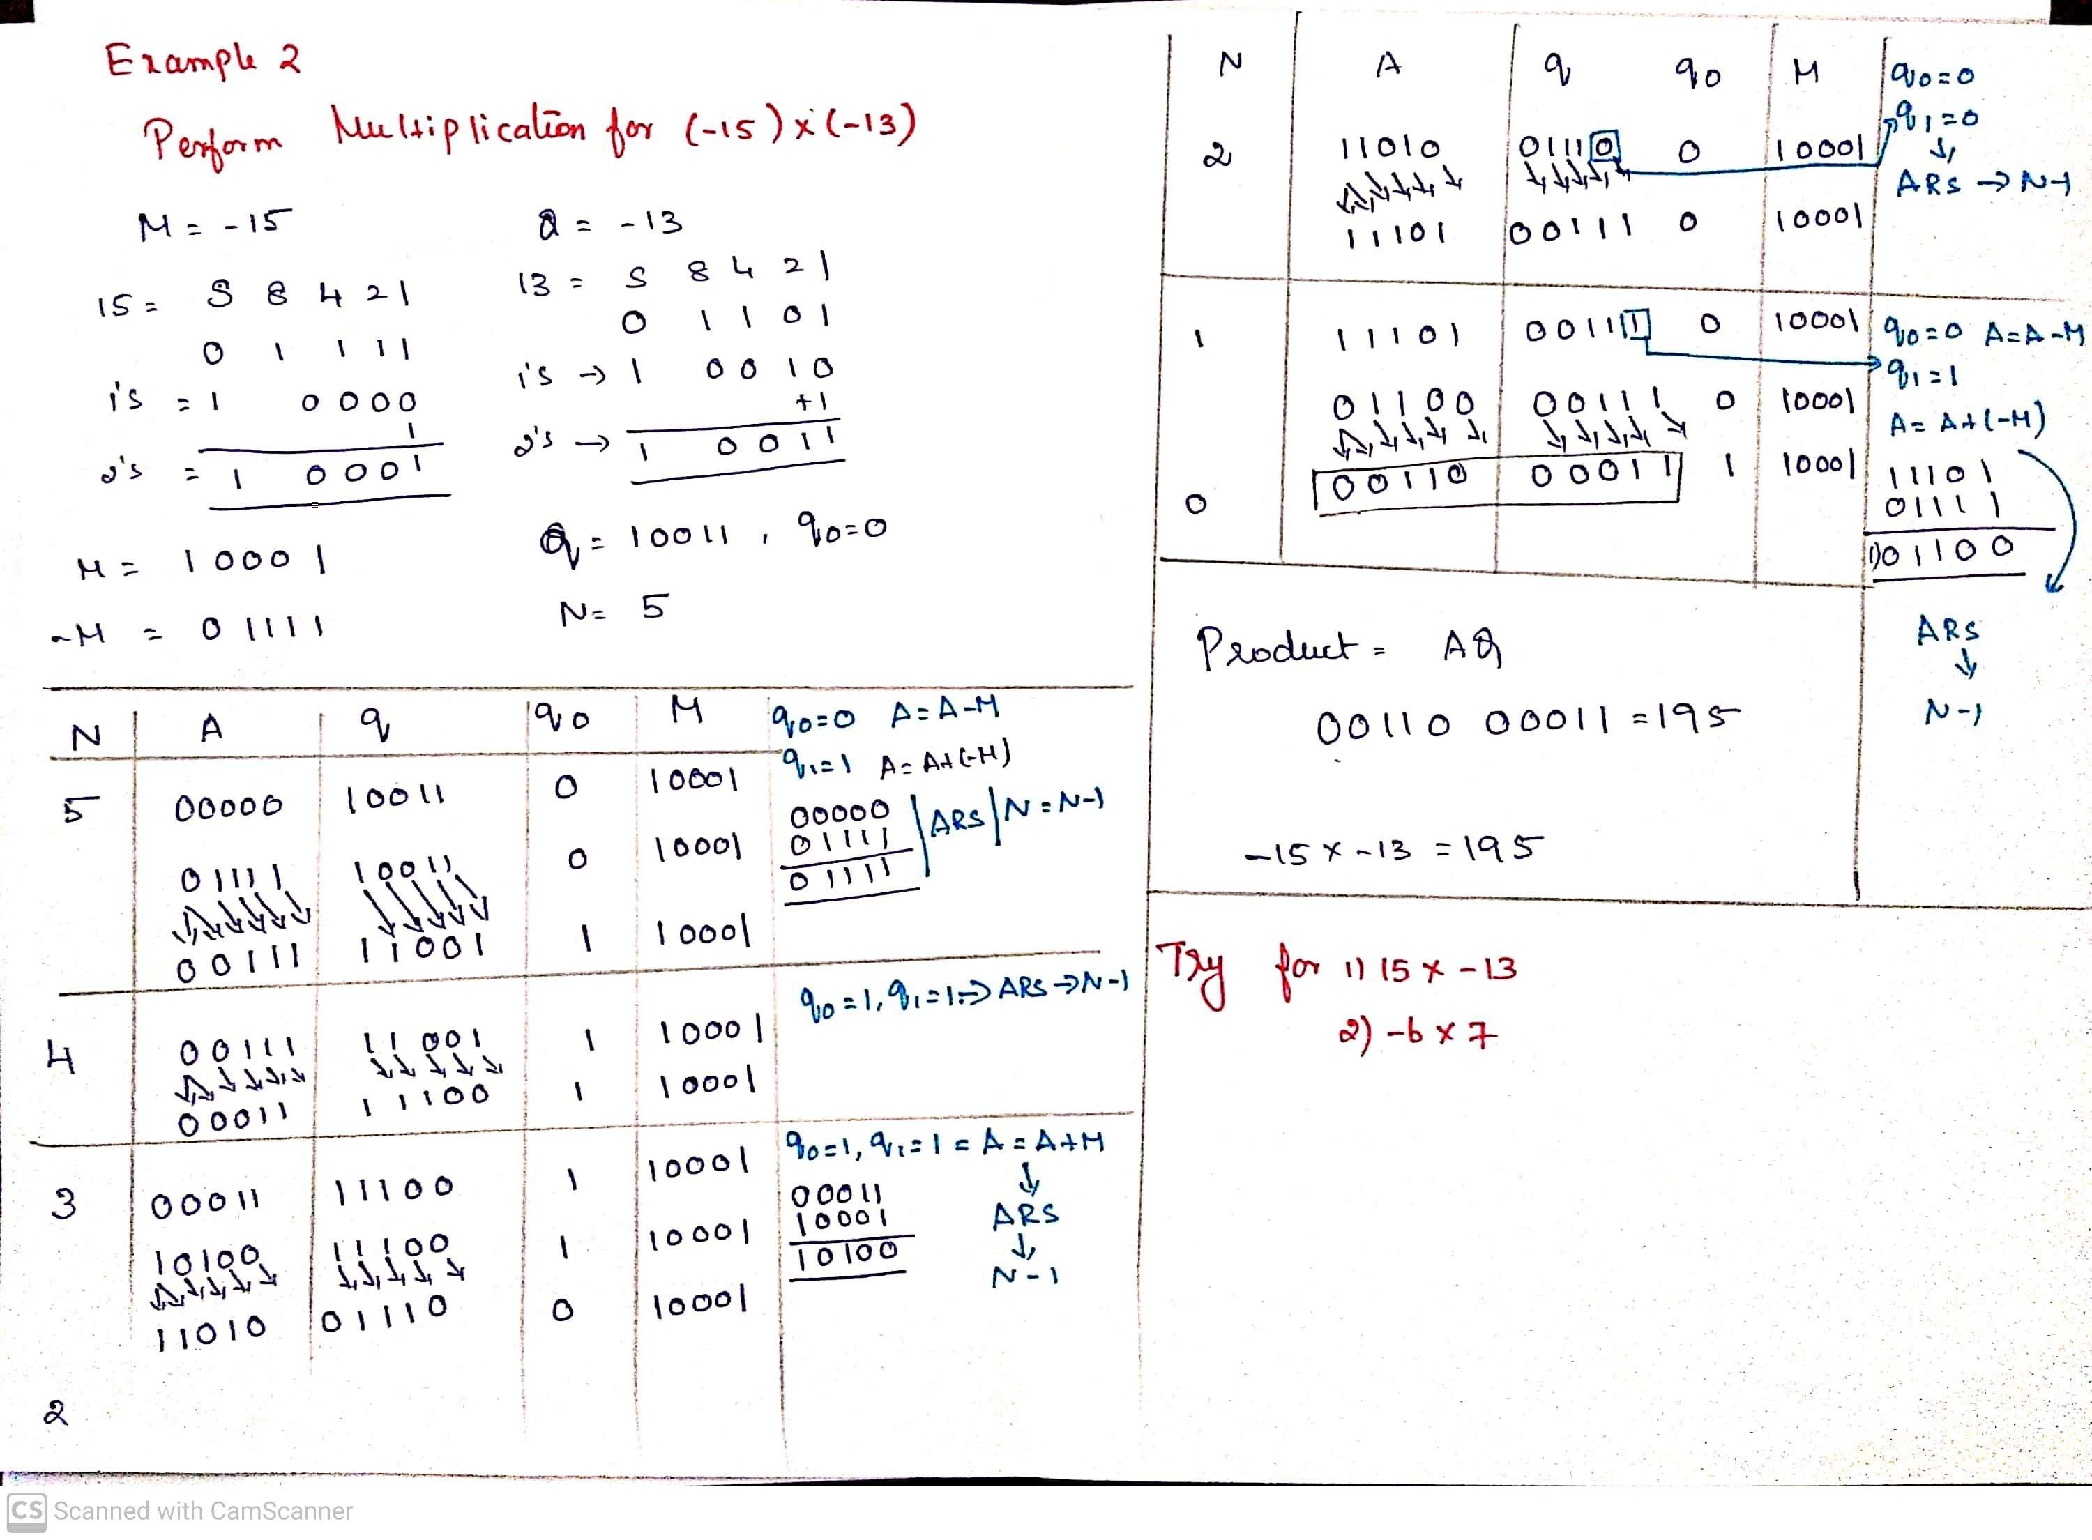

Slide 45
MULTIPLICATION
1.BOOTH RECODING OF MULTIPLERS 2.BIT PAIR RECODING OF MULTIPLIERS 3.CARRY SAVE ADDITION OF SUMMANDS

Slide 46
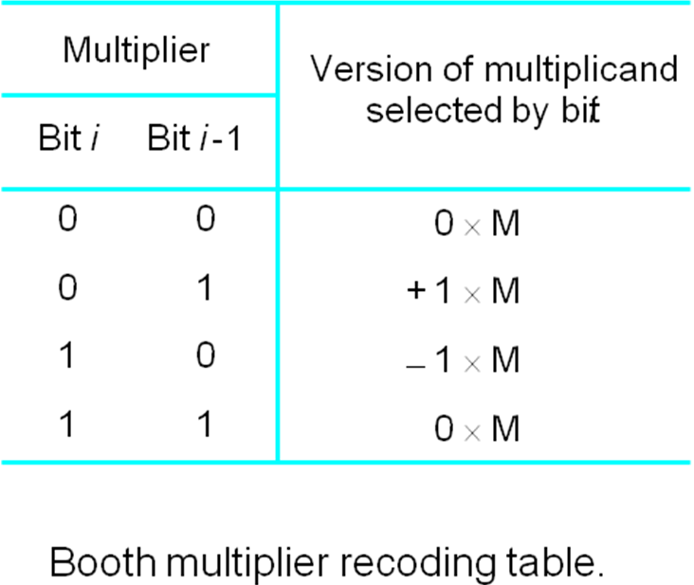
The BOOTH RECODED MULTIPLIER
Booth multiplication reduces the number of additions for intermediate results, but can sometimes make it worse as we will see.
Booth multiplier recoding table

Slide 47
The BOOTH RECODED MULTIPLIER
Booth Recoding:
30₁₀ : 0 1 1 1 1 0 0
+1 0 0 0 -1 0
(ii) 100₁₀: 0 1 1 0 0 1 0 0 0
+1 0 -1 0 +1 -1 0 0
(iii) 985₁₀: 0 0 1 1 1 1 0 1 1 0 0 1 0
0 +1 0 0 0 -1 +1 0 -1 0 +1 -1

Slide 48
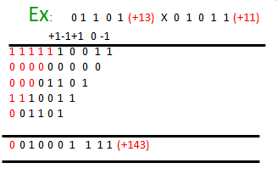
BOOTH Algorithm
Booth algorithm treats both +ve &
-ve operands equally.
(a) + Md X + Mr

Slide 49
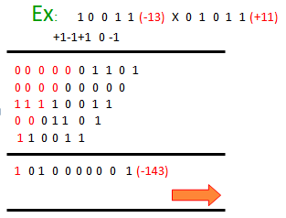
BOOTH Algorithm
Booth algorithm treats both +ve &
-ve operands equally.
(b) - Md X + Mr

Slide 50
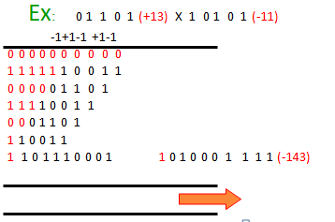
BOOTH Algorithm
Booth algorithm treats both +ve &
-ve operands equally.
(c) + Md X - Mr

Slide 51
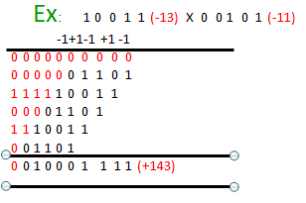
BOOTH Algorithm
Booth algorithm treats both +ve &
-ve operands equally.
(d) - Md X - Mr

Slide 52
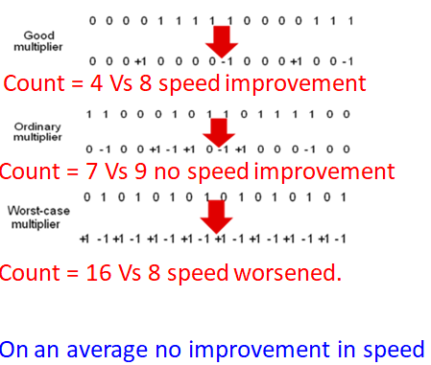
BOOTH Algorithm

Slide 53
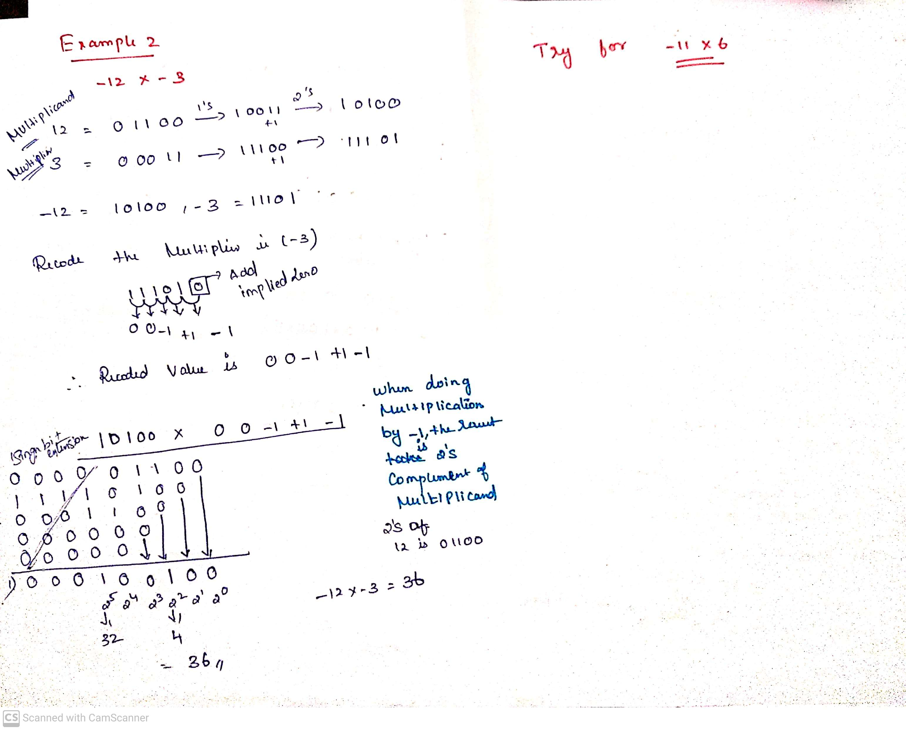

Slide 54
Fast Multiplication
There are two techniques for speeding up the multiplication operation.
The first technique guarantees that the maximum number of summands (versions of the multiplicand) that must be added is n/2 for n-bit operands.
The second technique reduces the time needed to add the summands (carry-save addition of summands method).

Slide 55
Bit-Pair Recoding of Multipliers
This bit-pair recoding technique halves the maximum number of summands. It is derived from the Booth algorithm.
Group the Booth-recoded multiplier bits in pairs, and observe the following: The pair (+1 -1) is equivalent to the pair (0 +1).
That is, instead of adding —1 times the multiplicand M at shift position i to + 1 x M at position i + 1, the same result is obtained by adding +1 x M at position I Other examples are: (+1 0) is equivalent to (0 +2),(-l +1) is equivalent to (0 —1). and so on

Slide 56
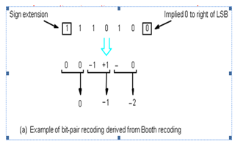
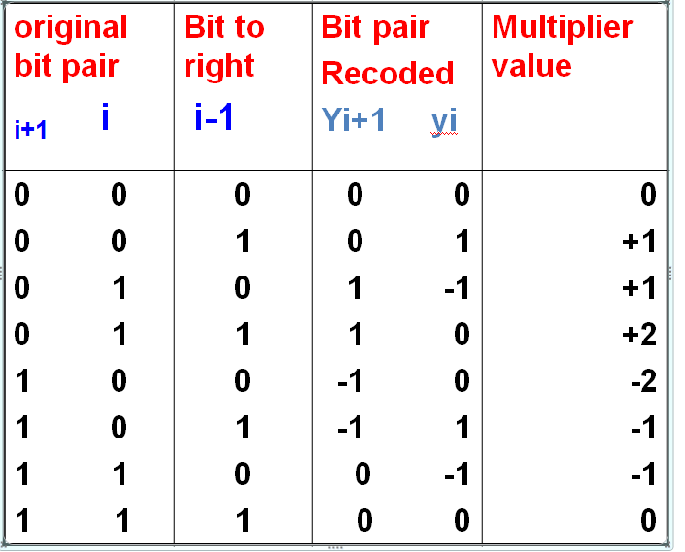
Bit-Pair Recoding of Multipliers

Slide 57
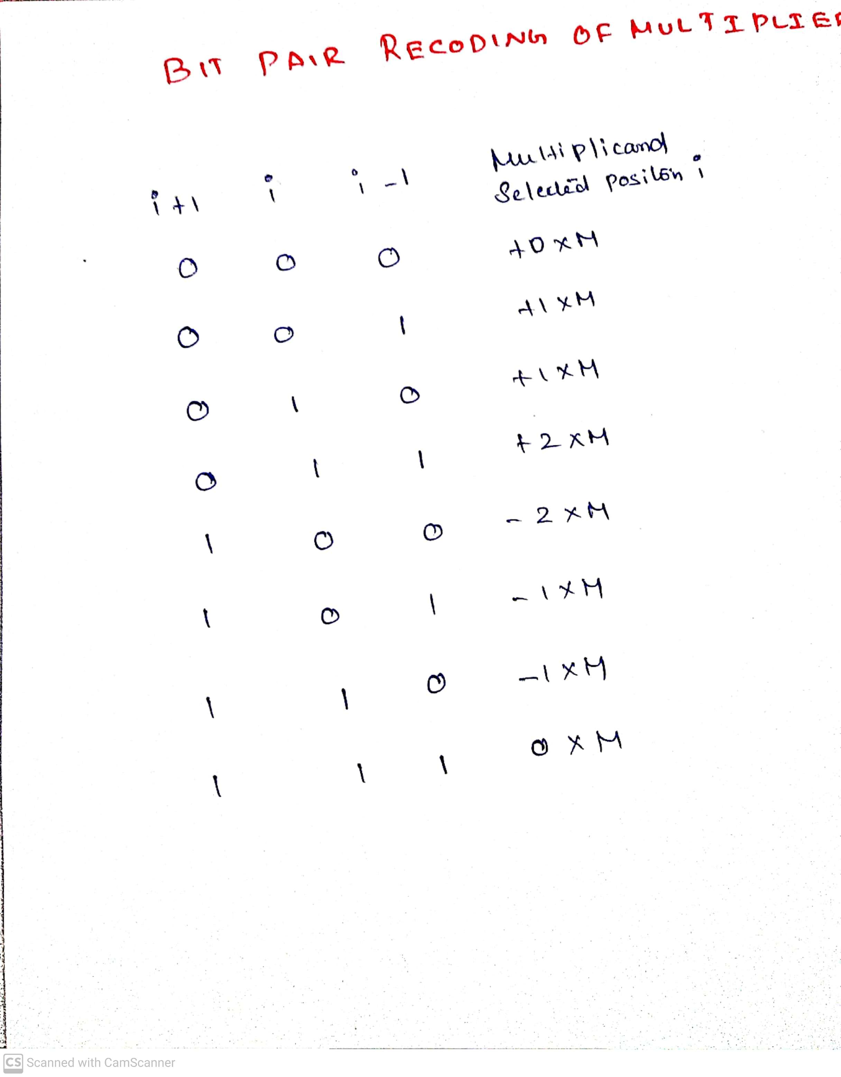

Slide 58
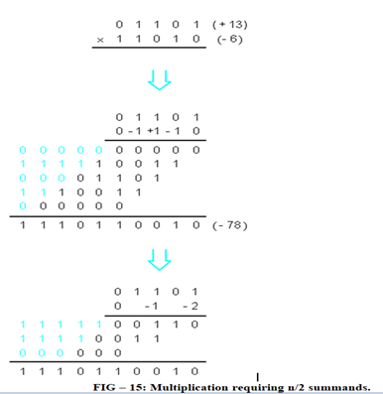
Bit-Pair Recoding of Multipliers

Slide 59
Carry-Save Addition of Summands
A carry-save adder is a type of digital adder, used to efficiently compute the sum of three or more binary numbers.
A carry-save adder (CSA), or 3-2 adder, is a very fast and cheap adder that does not propagate carry bits.
A Carry Save Adder is generally used in binary multiplier, since a binary multiplier involves addition of more than two binary numbers after multiplication.
It can be used to speed up addition of the several summands required in multiplication
It differs from other digital adders in that it outputs two (or more) numbers, and the answer of the original summation can be achieved by adding these outputs together.
A big adder implemented using this technique will usually be much faster than conventional addition of those numbers.
Fast Multiplication
Bit pair recoding reduces summands by a factor of 2
Summands are reduced by carry save addition
Final product can be generated by using carry look ahead adder

Slide 60
Carry-Save Addition of Summands
Disadvantage of the Ripple Carry Adder - Each full adder has to wait for its carry-in from its previous stage full adder. This increase propagation time. This causes a delay and makes ripple carry adder extremely slow. RCAr is very slow when adding many bits.
Advantage of the Carry Look ahead Adder - This is an improved version of the Ripple Carry Adder. Fast parallel adder. It generates the carry-in of each full adder simultaneously without causing any delay. So, CLAr is faster (because of reduced propagation delay) than RCAr.
Disadvantage the Carry Look-ahead Adder - It is costlier as it reduces the propagation delay by more complex hardware. It gets more complicated as the number of bits increases.
Notes:
Propagation delay is time elapsed between the submission of an input and occurrence of the corresponding output.

Slide 61

Ripple Carry Array

Slide 62

Carry Save Array

Slide 63
Carry-Save Addition of Summands
Consider the addition of many summands, We can:
Group the summands in threes and perform carry-save addition on each of these groups in parallel to generate a set of S and C vectors in one full-adder delay
Group all of the S and C vectors into threes, and perform carry-save addition of them, generating a further set of S and C vectors in one more full-adder delay
Continue with this process until there are only two vectors remaining
They can be added in a Ripple Carry Adder (RPA) or Carry Look-ahead Adder (CLA) to produce the desired product

Slide 64

Carry-Save Addition of Summands

Slide 65

Carry-Save Addition of Summands

Slide 66

Carry-Save Addition of Summands

Slide 67

Integer Division
More complex than multiplication
Negative numbers are really bad!
Based on long division

Slide 68

Integer Division
Decimal Division
Binary Division
Figure: Longhand division examples

Slide 69
Integer Division
Longhand Division operates as follows:
Position the divisor appropriately with respect to the dividend and performs a subtraction.
If the remainder is zero or positive, a quotient bit of 1 is determined, the remainder is extended by another bit of the dividend, the divisor is repositioned, and another subtraction is performed.
If the remainder is negative, a quotient bit of 0 is determined, the dividend is restored by adding back the divisor, and the divisor is repositioned for another subtraction

Slide 70
Restoring Division
Similar to multiplication circuit
An n-bit positive divisor is loaded into register M and an n-bit positive dividend is loaded into register Q at the start of the operation.
Register A is set to 0
After the division operation is complete, the n-bit quotient is in register Q and the remainder is in register A.
The required subtractions are facilitated by using 2’s complement arithmetic.
The extra bit position at the left end of both A and M accommodates the sign bit during subtractions.

Slide 71


Slide 72


Restoring Division
Figure: Logic Circuit arrangement for binary Division (Restoring)

Slide 73

Restoring Division
Figure: Flowchart for Restoring Division

Slide 74

Restoring Division

Slide 75

Restoring Division

Slide 76


Non-Restoring Division

Slide 77
Non-Restoring Division
Initially Dividend is loaded into register Q,
and n-bit Divisor is loaded into register M
Let M’ is 2’s complement of M
Set Register A to 0
Set count to n
SHL AQ denotes shift left AQ by one position leaving Q₀ blank.
Similarly, a square symbol in Q₀ position denote, it is to be calculated later

Slide 78

Non-Restoring Division
Figure: Flowchart for Non-Restoring Division

Slide 79


Non-Restoring Division

Slide 80

Non-Restoring Division

Slide 81

Non-Restoring Division

Slide 82


Slide 83


Slide 84


Slide 85
Floating Point Numbers and Operations
Floating Point Number Representation (FPR)
±Significant x Base^{±Exponent}
Example: +10.55 x 10⁵⁵
Why FPR?
Consider a very small number 0.00000000005
As it consists of many 0’s after the decimal point, it
requires more number bits for representation
0.00000000005 is represented as 0.5 x 10⁻¹⁰, it will require only fewer bits
Consider a very large number 50000000000 which can be represented as 5 x 10¹⁰ ⁽⁺⁵
Consider the example 0.123 x 10⁴ = 0.0123 x 10⁵ = 123 x 10³
But we need a fixed and single representation for floating point numbers. For this normalization is required.

Slide 86


Floating Point Numbers and Operations
Normalization rules for floating point number
There are 2 rules:
The integer part should be 0 _{n}
0.d₁d₂...d_{n} x B^{±E} then d₁ > 0 and all d_{i} ≥ 0
^{i=2}
In the example 0.123 x 10⁴ = 0.0123 x 10⁵ = 123 x 103, the strikethrough representations are wrong with respect to normalization rules.
Two floating point representation techniques are,
Single precision (32 bits or 4 bytes)
Double precision (64 bits or 8 bytes)

Slide 87


Slide 88

Floating Point Numbers and Operations
Single Precision and Double Precision Format

Slide 89

Floating Point Numbers and Operations
Decimal number into IEEE 754 32-bit floating point number

Slide 90
Floating Point Numbers and Operations
Floating Point Arithmetic Addition/Subtraction
Steps to add/subtract two floating point numbers:
Compare the magnitudes of the exponents and make suitable alignment to the number with the smaller magnitude of exponent
Perform the addition/subtraction
Perform normalization by shifting the resulting mantissa and adjusting the resulting exponent
Example: Add 1.1100 x 2⁴ and 1.1000 x 2²
1. Alignment: 1.1000 x 2² has to be aligned to 0.0110 x 2⁴ 1.1100
2. Addition: Add the numbers to get 10.0010 x 2⁴ 0.0110
3. Normalization: Find normalized result 10.0110
0.1000 x 2⁶ (assuming 4-bits are allowed after
decimal point)

Slide 91

Floating Point Numbers and Operations
Floating Point Arithmetic Addition/Subtraction

Slide 92

Going Beyond Integers : Floating Point
Programming languages support numbers with real numbers i.e., fractions
These fractions are floating point numbers
Examples:
$π$=Pi value is 3.14159……
e= Euler Number is 2.71828…..
Nanoseconds in a day=86,400,000,000,000 ns
The last numbers is large integer that cannot fit in 32-bit integer.

Slide 93
Floating Point Numbers : Scientific Notation
We use scientific notation to represent fraction/floating point numbers. It has single digit to the left of decimal point.
A number 0.000000001_{ten} can be represented as 1.0_{ten} x 10^{–9}
Small number:
Mass of neutron=1.67 x 10⁻²⁷ kg
Seconds in nanosecond=1.0 x 10⁻⁹ s
Large number:
Mass of earth=5.92 x 10²⁴ kg
Seconds in a century=3.16 x 10⁹ s
Nanoseconds in a day=8.64 x 10¹³ ns

Slide 94

Floating Point Numbers :Normalized Scientific Notation

Slide 95


Floating Point Representation: IEEE 754 Standard
A floating point number is represented using three fields: sign bit, exponent and fraction field

Slide 96

IEEE 754 Floating Point Standard Cntd…
Possibility : numbers(large)

Slide 97

IEEE 754 Floating Point Standard Cntd…
Underflow or overflow problems: solved using exponent(larger)
The following is IEEE 754 double precision floating point format.
This floating point number takes two 32-bit word. S is single bit sign,
11-bits exponent field, 52-bits fraction field.

Slide 98

Biased Exponent Representation
IEEE 754 : exponent -biased representation
For single precision, IEEE 754 uses a bias of 127.
So -1 is represented as -1+127=126₁₀= 0111 1110₂(Exponent)
+1 is represented as 1+127=128₁₀= 1000 0000₂
For double precision, IEEE 754 uses a bias of 1023.

Slide 99

Exercise 1:

Slide 100

Exercise 2:

Slide 101

Exercise 3: Find the decimal value for the given IEEE 754 binary representation

Slide 102


Slide 103


Slide 104


Slide 105

Floating Point Addition
Question: Add 0.5₁₀ and –0.4375₁₀ in binary.

Slide 106

Floating Point Multiplication

Slide 107


Slide 108


Slide 109


Slide 110
Floating point arithmetic: DIV rule
Subtract the exponents
Add the bias.
Divide the mantissas and determine the sign of the result.
Normalize the result if necessary.
Truncate/round the mantissa of the result.
Note: Multiplication and division does not require alignment of the
mantissas the way addition and subtraction does.

Slide 111
Non-Numeric value (character) encoding/ decoding
ASCII - American Standard Code for Information Interchange
Unicode - universal character encoding standard used for representation of text for computer processing.
Unicode and ASCII are the most popular character encoding standards that are currently being used all over the world. Unicode is the universal character encoding used to process, store and facilitate the interchange of text data in any language while ASCII is used for the representation of text such as symbols, letters, digits, etc. in computers
Unicode and ASCII are the standards for text encoding, and they hold the utmost significance in modern communications.

Slide 112


Slide 113


